Slide 1

Daily website visit forecasting
Bo Yun
Notes:
Hi, My name is Bo Yun
And I m here to present a timeseries forecasting with the data on daily website visit.

Slide 2
Introduction
Background
Data type – Daily Website Visitors
Original data : 2100 entries
Reduced data : 500 entries
4 variables (Page Loads, Unique Visits, First Time visits, Returning visits )
Response variable
Page Loads
Model fitting
ARMA, ARIMA => Univariate models
MLR, VAR and NN => Multivariate models
Notes:
Let me give you the background before we dive into modeling.
The data has the number of website visitors to an academic teaching website that was collected from 2014 to 2020.
To easily visualize and identify key changes, I decided to reduce it down to 500 days of data.
There are four variables in this data and Page.Loads will be the the response variable for the purpose of this study.
For model fitting, both ARMA and ARIMA are used for univariate models and multiple linear regression, Vector autoregressive and neural network are used for multivariate models.

Slide 3
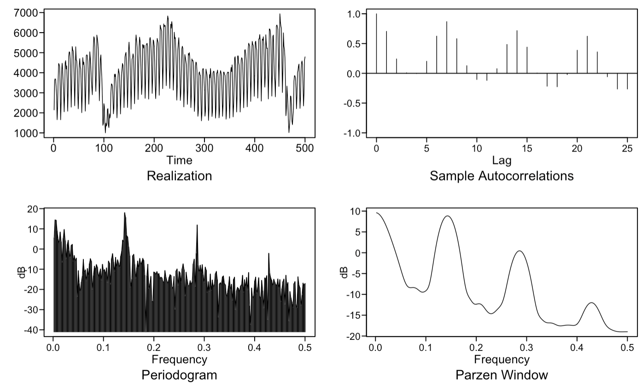
Data characteristics – Overview
Overview
Realization
ACF
Spectral density
Notes:
Here we see that the realization appears to have a seasonality, which can be confirmed by the slowly damping sinusolidal acf plot
In the spectral density graph, we see a bit of wandering and some periodic behaviors. The most prominent frequency peaks are 0 and 0.147, which indicate a wandering behavior and a weekly trend. We will keep this in mind as we explore different models.

Slide 4
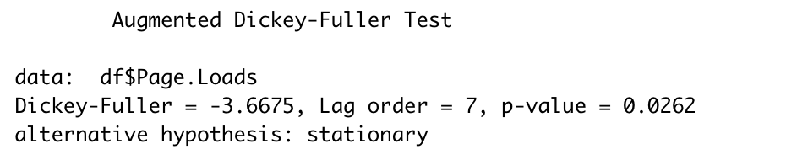
Data characteristics – Stationarity check 1
Dickey Fuller test
Rejected the null hypothesis
=> The data is stationary, DF test alone can’t fully be trusted
Notes:
First I wanted to check the stationarity of the data. So I conducted a dickey fuller test, in which the outcome rejected the null hypothesis, meaning that the data is stationary. However, this needs to be looked at further since it is very close to the 0.05 cut off p value and can’t fully be trusted by itself.

Slide 5
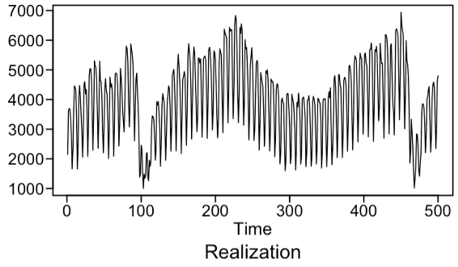
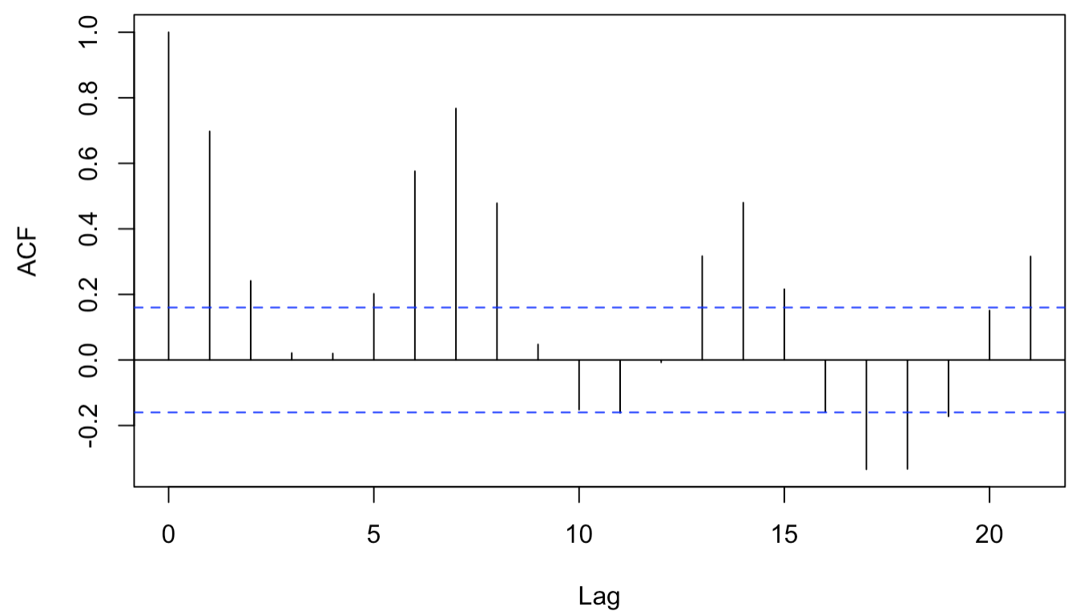
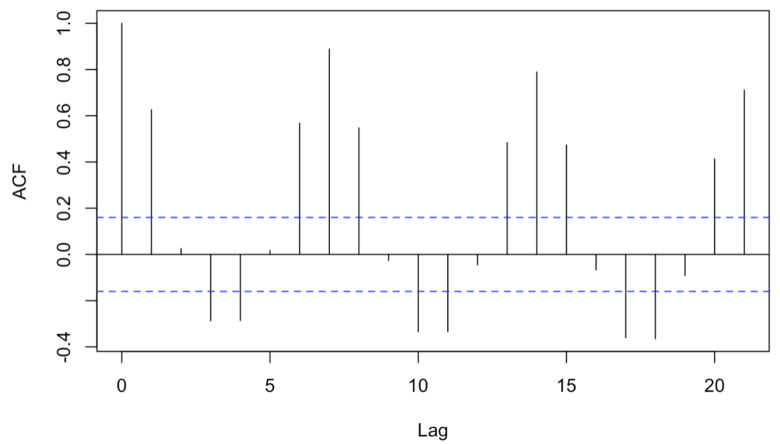
Data characteristics – Stationarity check 2
Condition 1 : Constant mean
Seemed to be centered around the mean
However, there is seasonality present
Domain knowledge
Condition 2 : Constant variance
Assumed constant
Condition 3 : Constant correlation
Data split in half and ACF compared
Appear constant
First half ACF
Second half ACF
Notes:
So I wanted to visually check each condition of stationarity.
Although it appears that it has a constant mean, it is the domain knowledge of being a daily visit data along with the observed seasonality in the acf plot that break the first condition of stationarity. The condition 2 of Constant variance is assumed in this data.
Next, the data is split in half and each acf is compared and verified to have a constant correlation.
Overall, due to breaking condition 1, the data is concluded to be non-stationary.

Slide 6
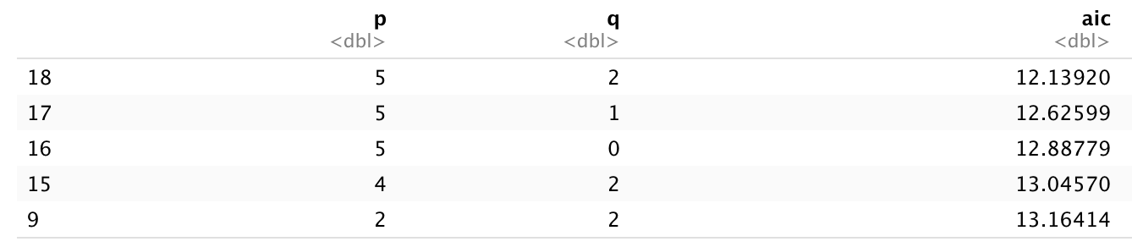
Model 1 – ARMA(5,2)
Fitting ARMA model with p and q based on AIC
Estimating the model with p and q given above
phi=1.7891, -2.0469 ,1.7728 ,-1.3226, 0.7625
theta=1.0121871, -0.7784402
mean=3954.95
variance=174725.7
AIC=12.12
Final ARMA model – Factored form
(1-0.9729B)(1-1.2426B+0.9954B^2)(1+0.4264B+0.7873B^2)(Xt-3954.95)=(1-1.0122B+0.7784B^2)at, variance=181171.8
Notes:
The final ARMA model is estimated with parameters that give the lowest AIC

Slide 7
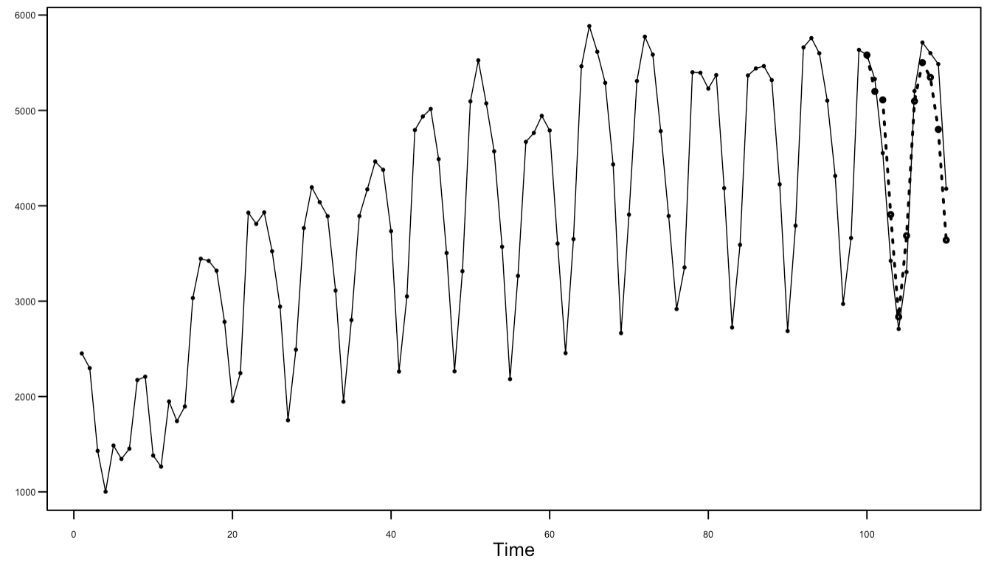
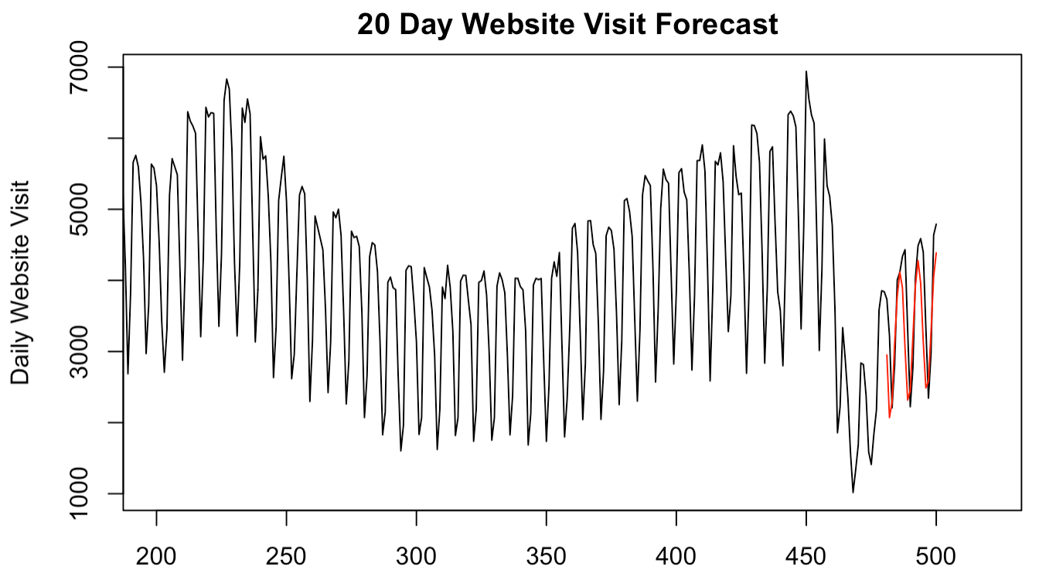
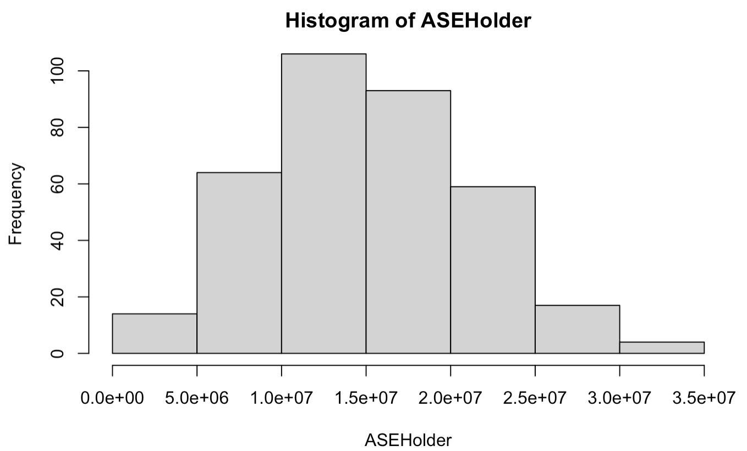
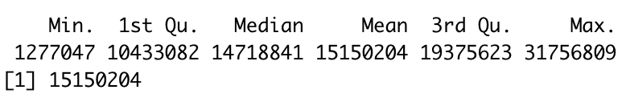
Model 1 – ARMA(5,2)
Validating the model with last 20 days of data
ASE = 444329.2
Validating the model with rolling ASE
Histogram
Statistics of rolling ASE result
Mean
Notes:
Here I validated the model with the last 20 days of data. It turns out that the forecasts were tracking the original data pretty well.
Also a rolling window was used to calculate the average ASE across the entire dataset.

Slide 8
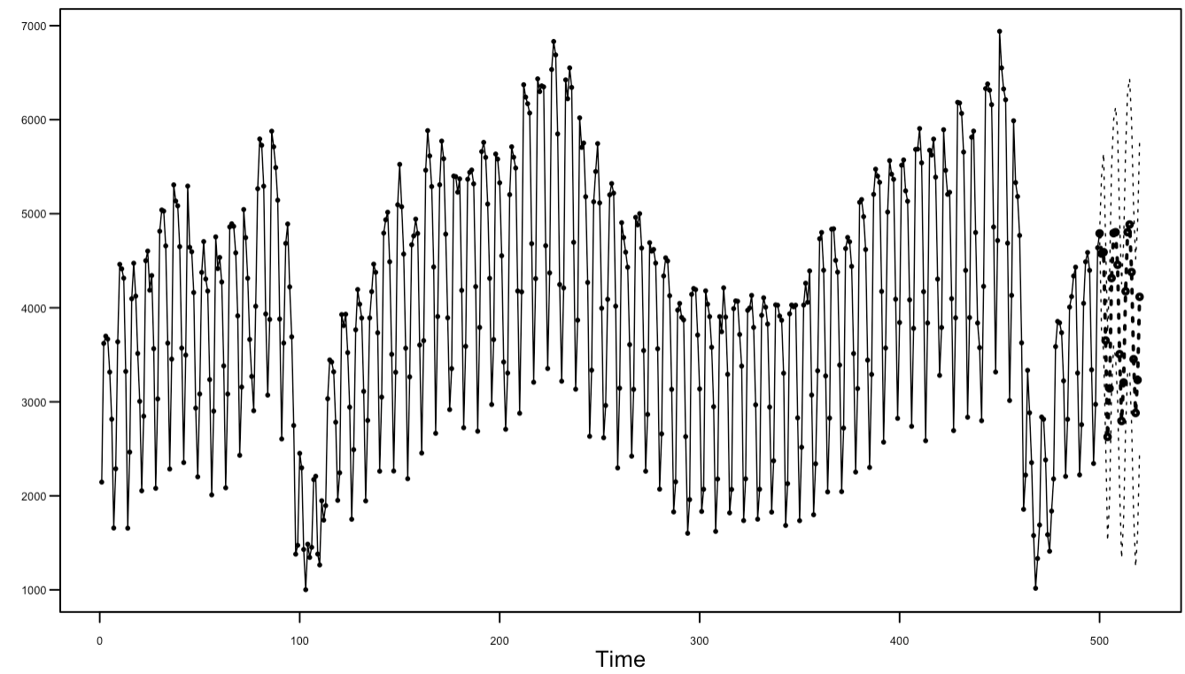
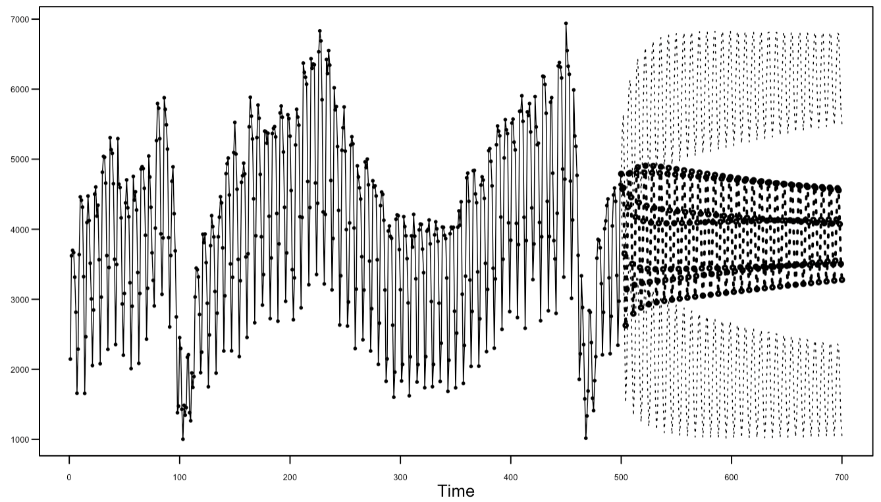
Model 1 – ARMA(5,2)
Short term prediction – 20 days ahead
Long term prediction – 200 days ahead
Notes:
The ARMA model overall did a good job forecasting as it has the ability to converge toward the mean.

Slide 9
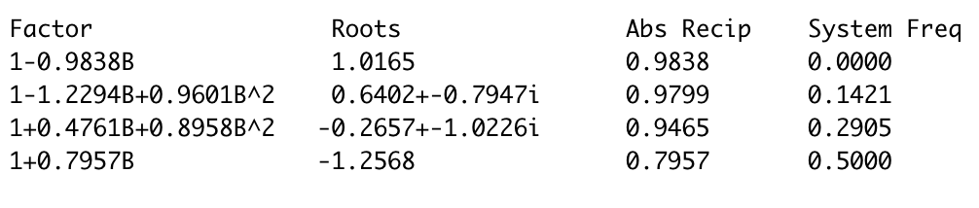
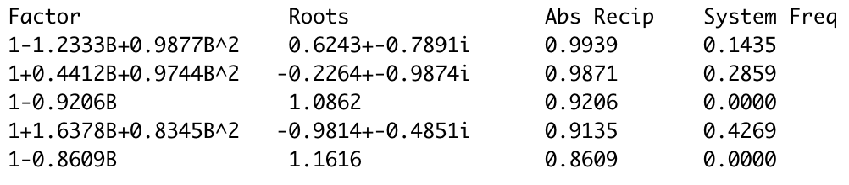
Model 2 – ARIMA(3,1,1) with s=7 – Stationarizing 1
Differencing unit root term (1-B)
Using Tiao/Tsay overfitting the model with higher order AR models AR(6) and AR(8), unit root term (1-B) is identified in the model.
AR(6) factors
AR(8) factors
Notes:
Now let’s take a look at the ARIMA model.
First, using the overfitting table with AR 6 and 8, the unit root term is identified.

Slide 10
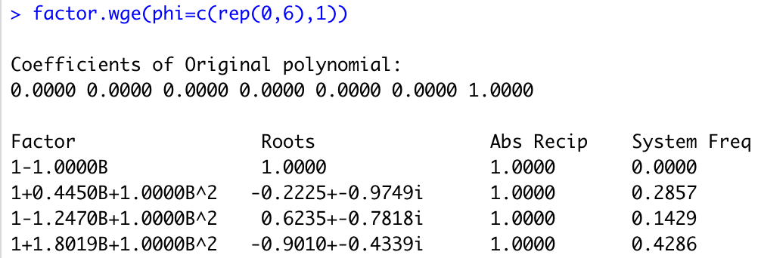
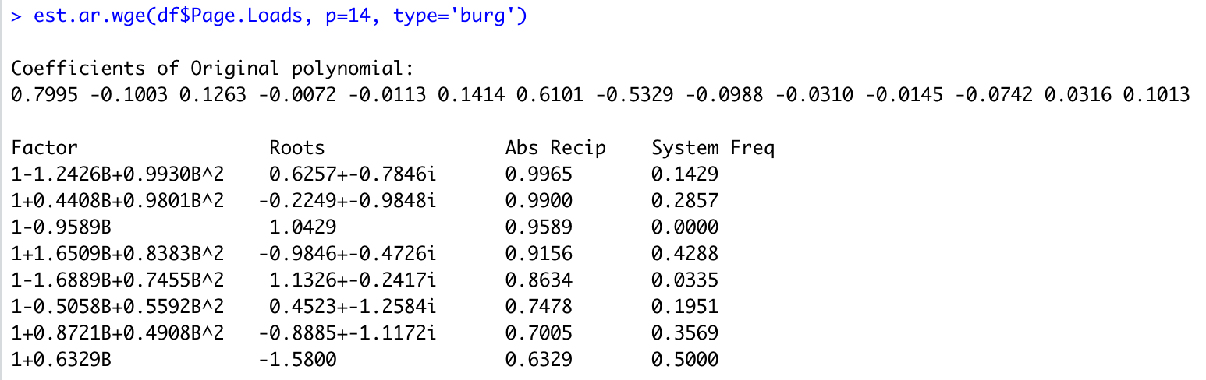
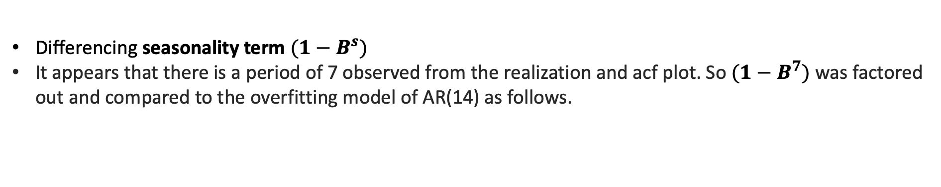
Model 2 – ARIMA(3,1,1) with s=7– Stationarizing 2
Differencing seasonality term $({1−B}^{s})$
It appears that there is a period of 7 observed from the realization and acf plot. So $({1−B}^{7})$ was factored out and compared to the overfitting model of AR(14) as follows.
Notes:
Next, comparing (1-B^7) and AR(14) tables, the seasonality term (1-B^7) is identified.
Complex conjugate roots are associated with the seasonality and damping sinusoidal pattern on the acf and is shown that two of conjugate roots are close to the unit root, which is why the sinusoidal behavior is dominant on acf.

Slide 11
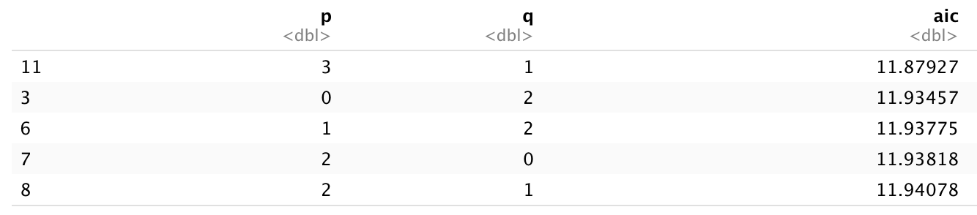
Model 2 – ARIMA(3,1,1) with s=7
Fitting the differenced ARIMA model with p and q based on AIC
Estimating the model with p and q given above
phi=0.8511057 ,-0.1379100, 0.1083783
theta=1
mean=3954.95
variance=141342.4
AIC=11.87
Final ARIMA model – Factored form
(1-B)(1-0.8404B)(1-0.0107B+0.1290B^2)(1-B^7)(Xt-3954.95)=(1-B)at, variance=141342.4
Notes:
The final ARIMA model is estimated after differencing the trend and seasonality.

Slide 12
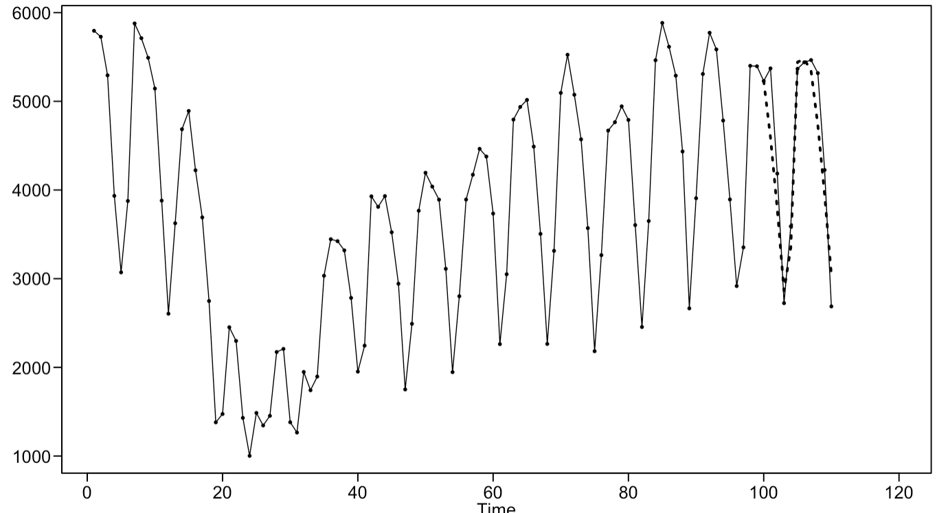
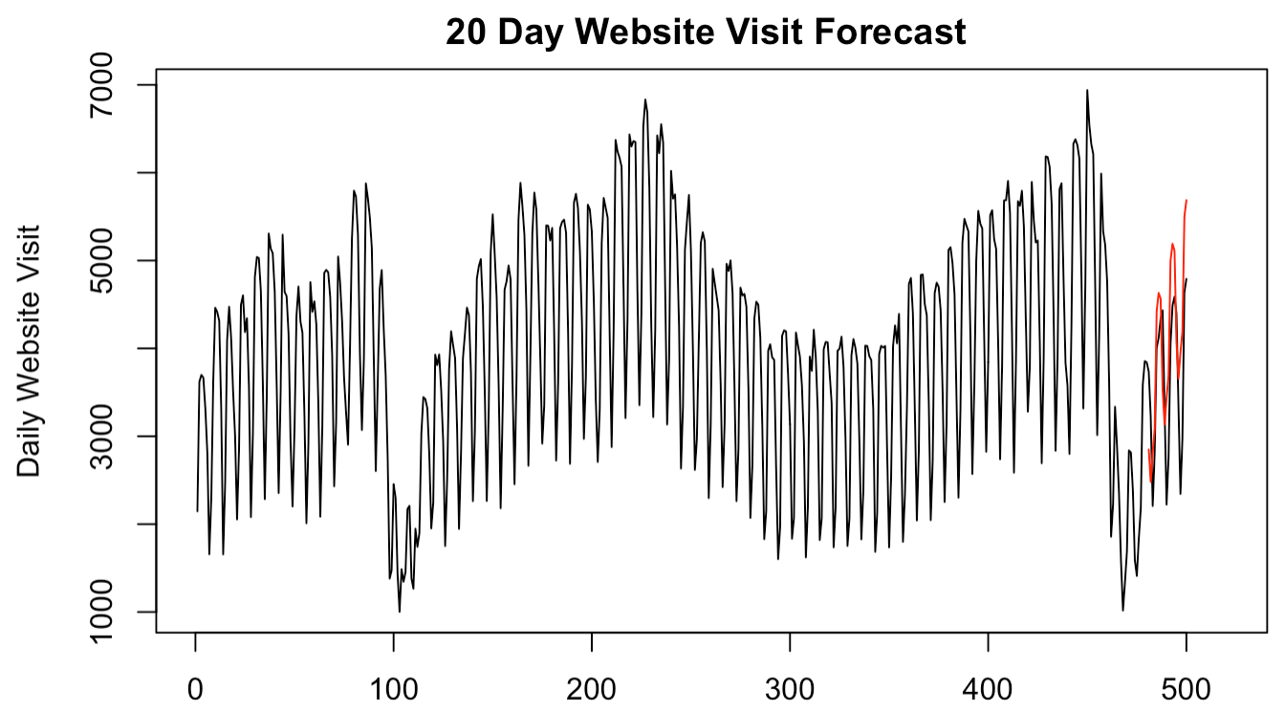
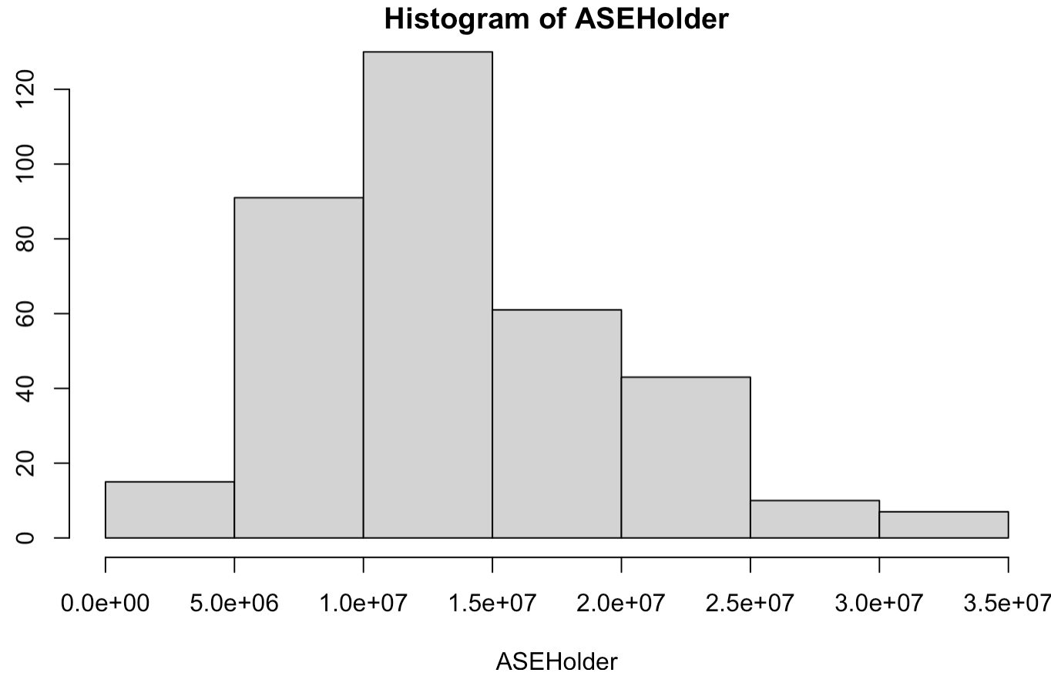
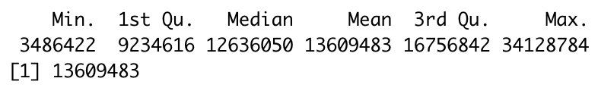
Model 2 – ARIMA(3,1,1) with s=7
Validating the model with last 20 days
ASE = 646923.3
Validating the model with rolling ASE
Mean
Notes:
Using the final model, the last 20 days are forecasted and compared with the actual data. Also the rolling window ASE came out to be around 13 million, which is slightly less than the ARMA model.

Slide 13
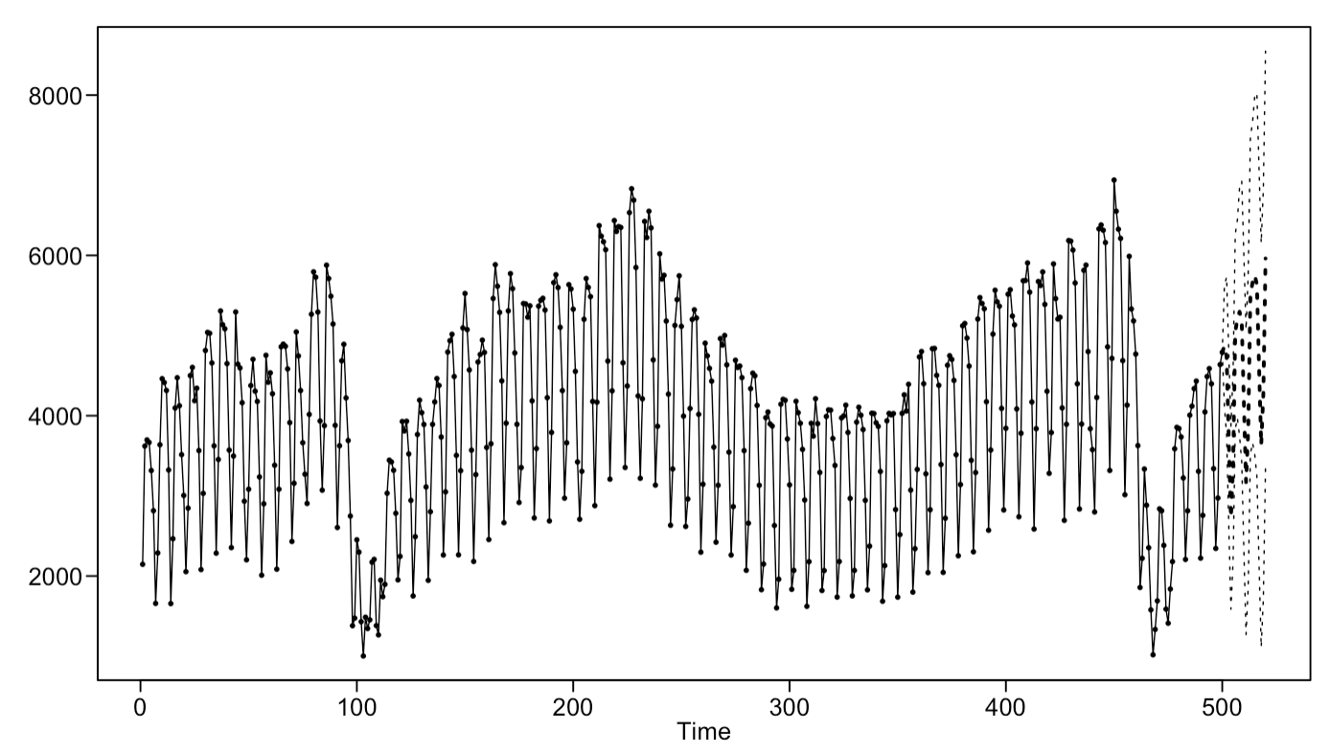
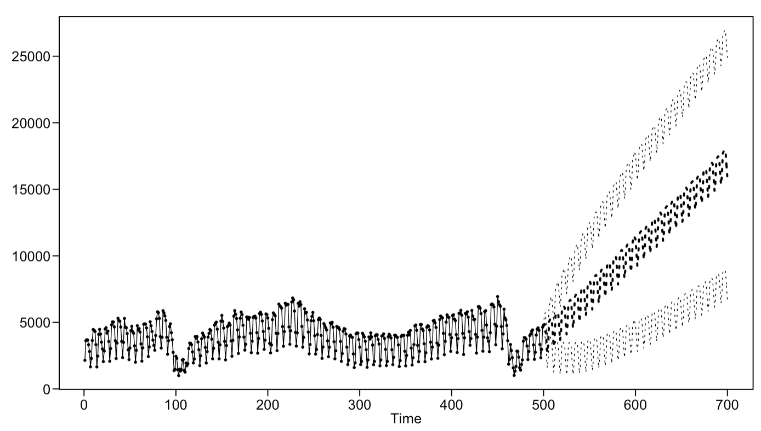
Model 2 – ARIMA(3,1,1) with s=7
Short term prediction – 20 days ahead
Long term prediction – 200 days ahead
Notes:
Short term forecasts look okay, however, due to having a trend term in the model, the upward trend in forecasting continues as well as the prediction limits grow sideways due to the seasonal component. For long term forecasting, this model is definitely not a good fit.

Slide 14
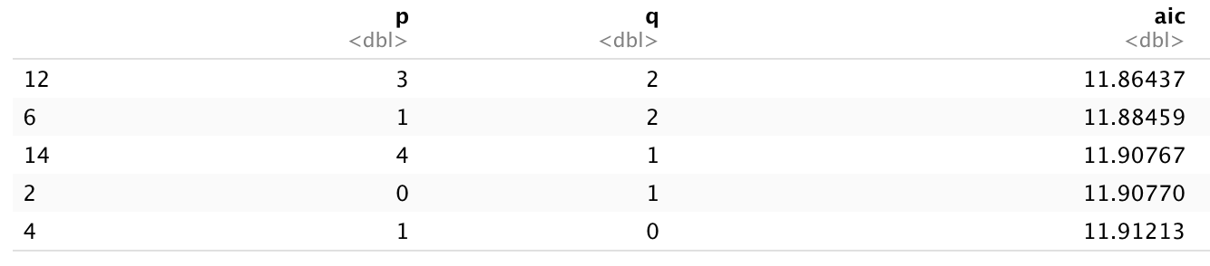
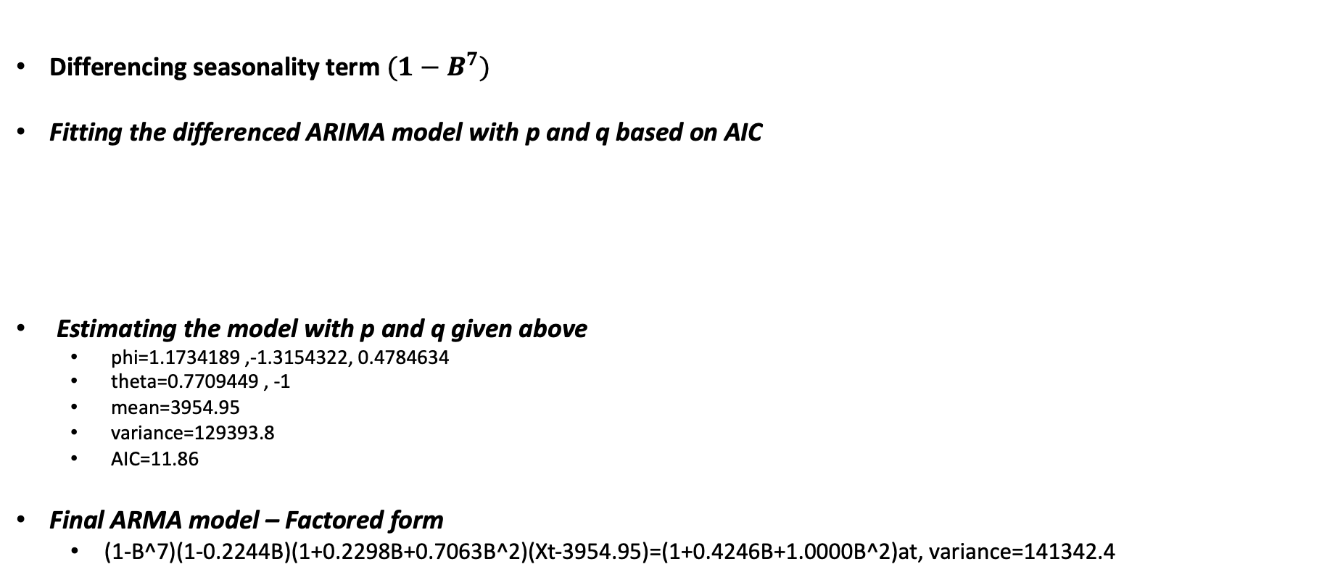
Model 3 – ARIMA(3,0,2) with s=7
Differencing seasonality term $({1−B}^{7})$
Fitting the differenced ARIMA model with p and q based on AIC
Estimating the model with p and q given above
phi=1.1734189 ,-1.3154322, 0.4784634
theta=0.7709449 , -1
mean=3954.95
variance=129393.8
AIC=11.86
Final ARMA model – Factored form
(1-B^7)(1-0.2244B)(1+0.2298B+0.7063B^2)(Xt-3954.95)=(1+0.4246B+1.0000B^2)at, variance=141342.4
Notes:
Here in this new model with just seasonality of 7, I wanted to see how getting rid of the trend term helps with the long term forecasting.

Slide 15
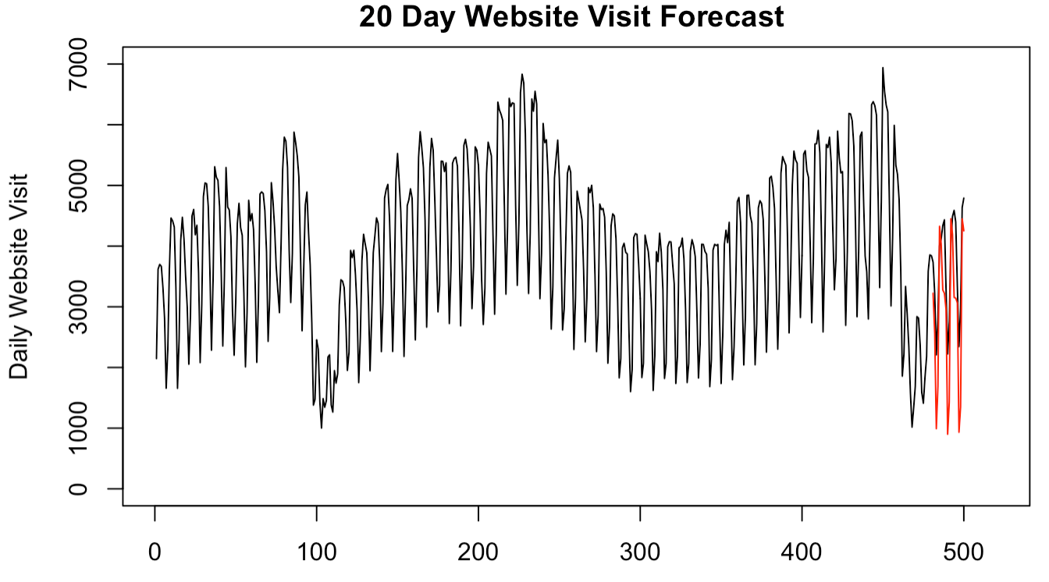
Model 3 – ARIMA(3,0,2) with s=7
Validating the model with last 20 days
ASE = 934133.1
Notes:
The forecasts lines up pretty well with the actual data in terms of accouting seasonality

Slide 16
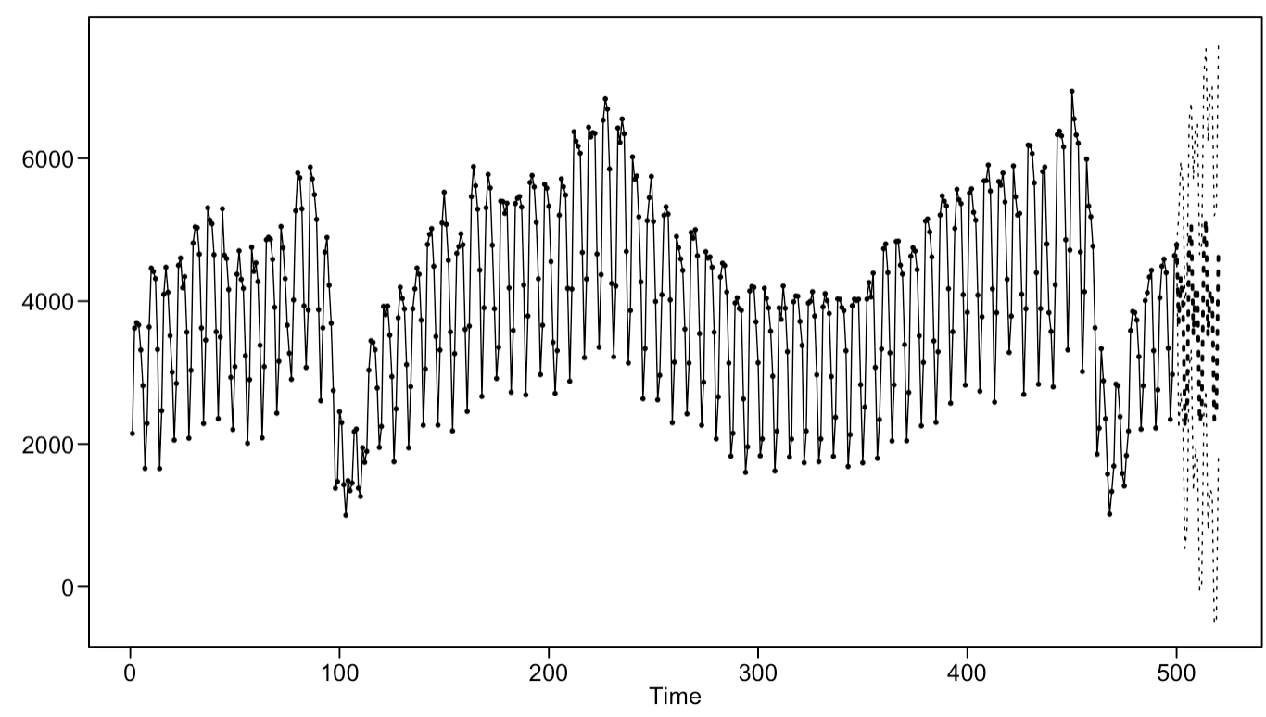
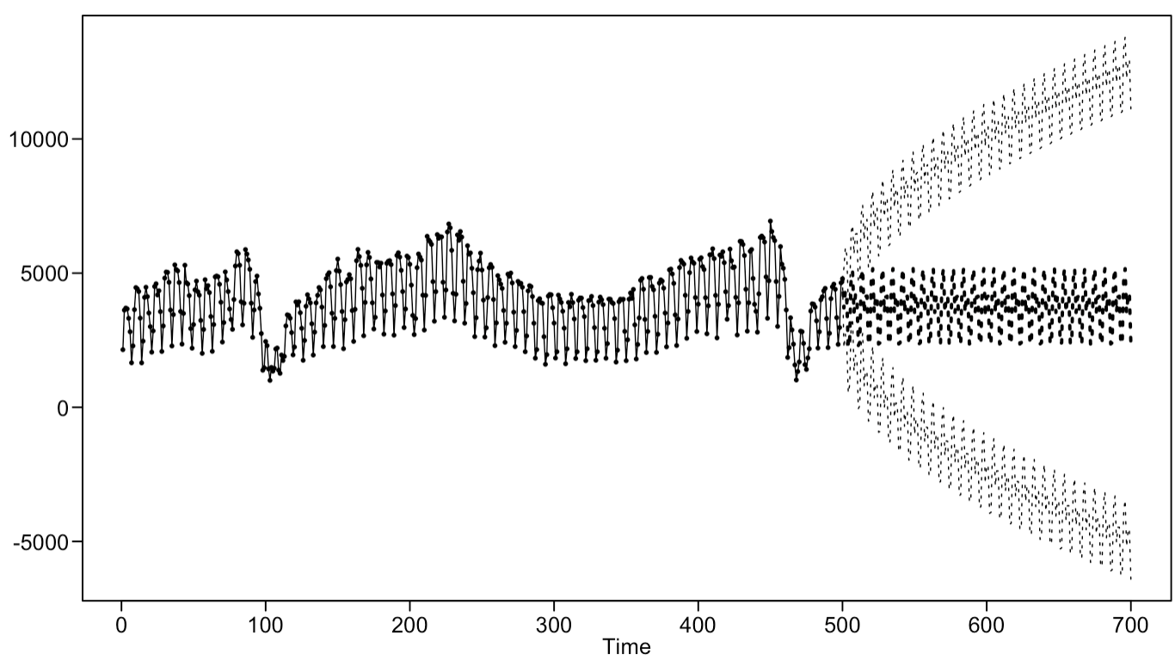
Model 3 – ARIMA(3,0,2) with s=7
Short term prediction – 20 days ahead
Long term prediction – 200 days ahead
Notes:
For this model, the forecasts centers around the mean pretty well due to ARMA component while the prediction limits keep growing sideways due to the seasonal component

Slide 17
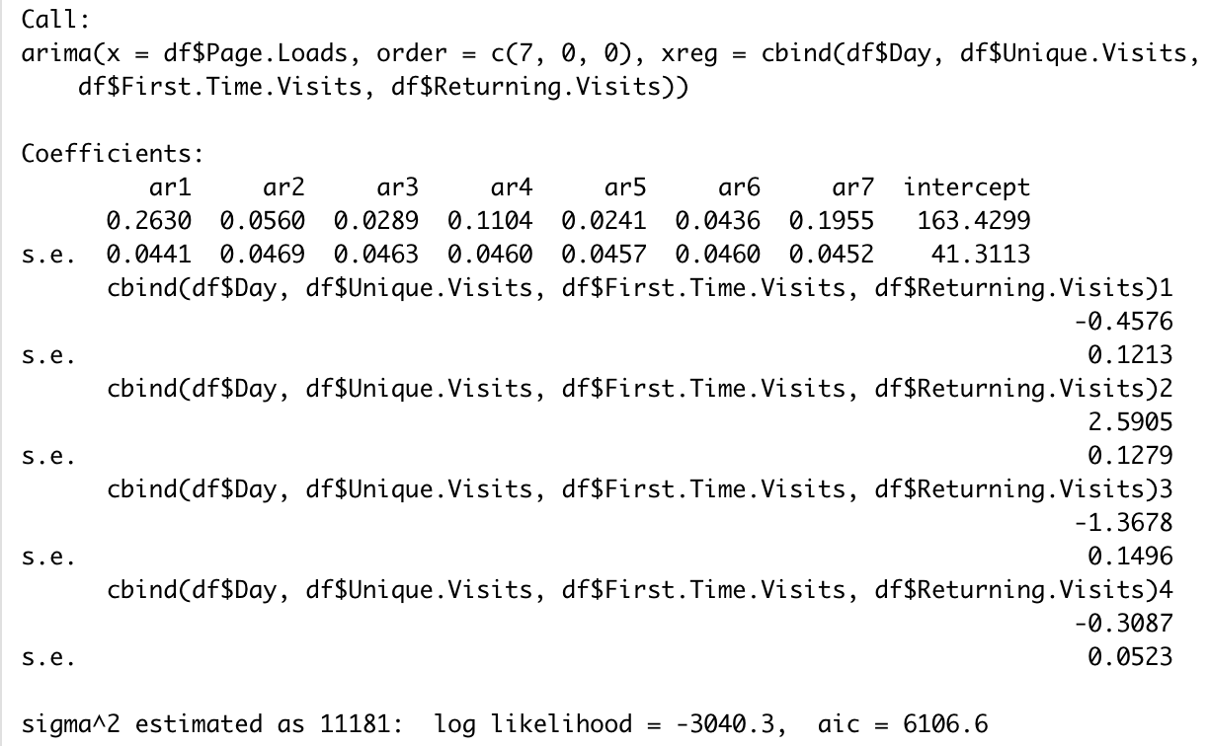
Model 4 – MLR with correlated errors
All variables(Day, Unique.Visits, First.Time.Visits, Returning.Visits) are significant
Notes:
When fitting multiple linear regression model into the data, all four variables utilized in the model turned out to be very significant.

Slide 18
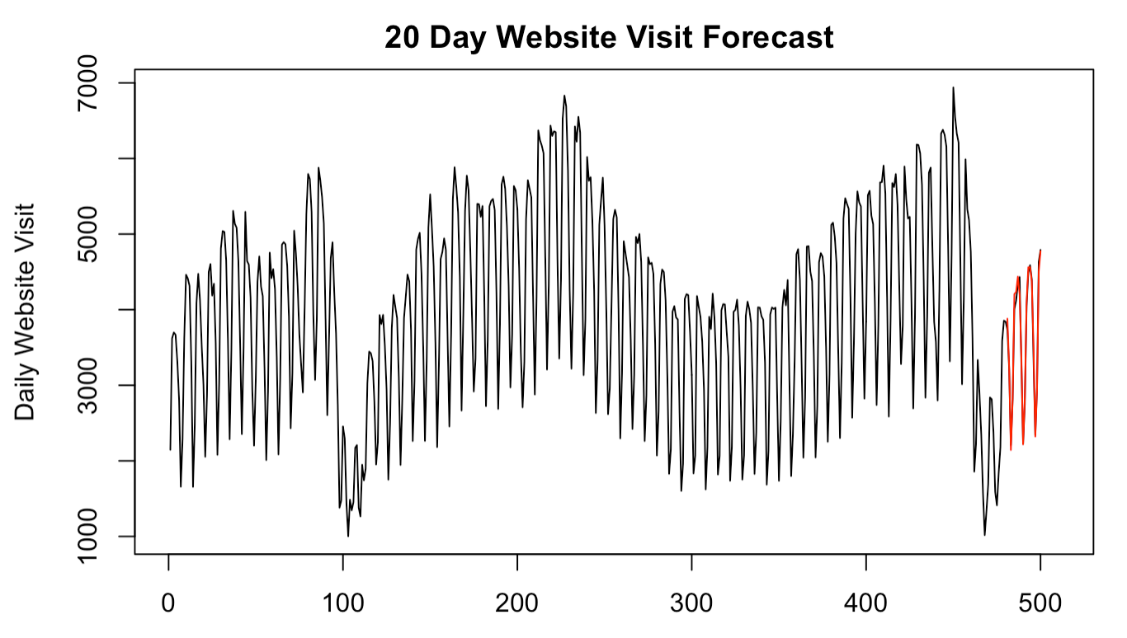
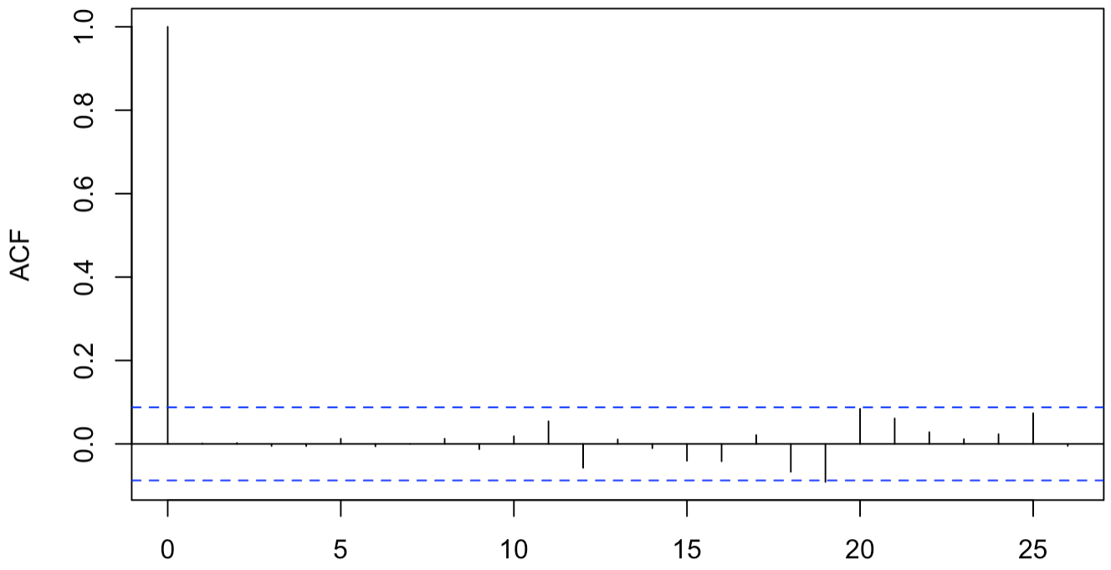
Model 4 – MLR with correlated errors
ASE = 10402.91
Residual ACF plot
P value = 0.7612
Final MLR model
Expected Daily Website Visit = 163.4299-0.4576*(Day)+2.5905*(Unique.Visits)-1.3678*(First.Time.Visits)-0.3087*(Returning.Visits)
Notes:
ASE was 10402.91, which is very good compared to other models discussed previously.

Slide 19
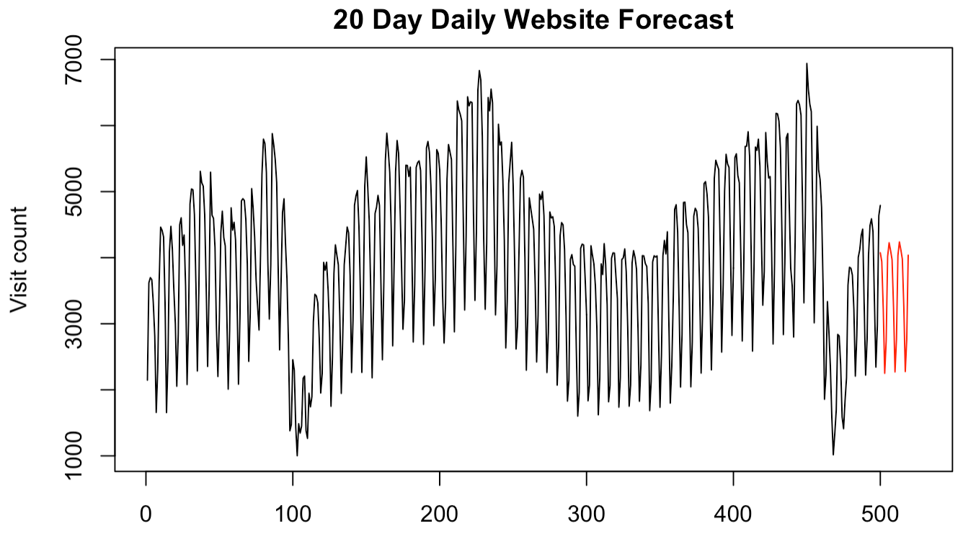
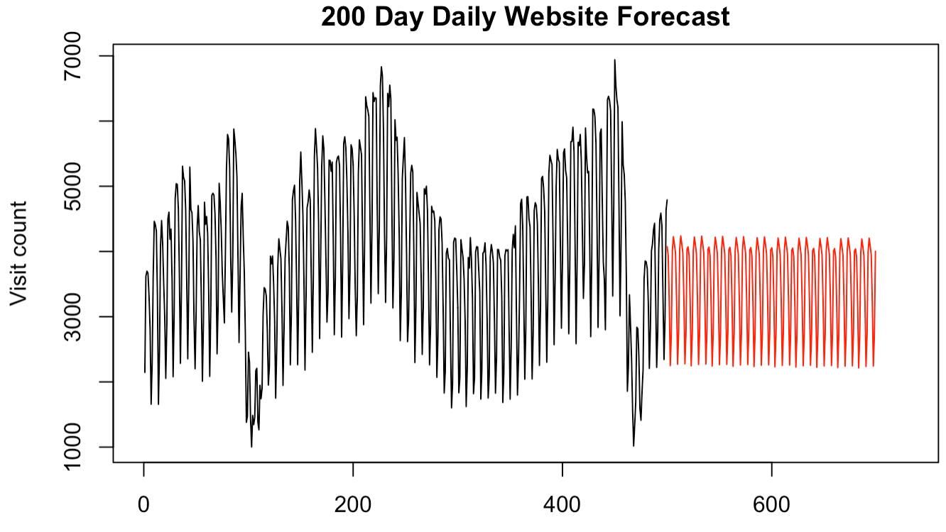
Model 4 – MLR with correlated errors – Using forecasted regressors
Short term prediction – 20 days ahead
Long term prediction – 200 days ahead
Notes:
Due to regressors being forecasted with ARMA models, the resulting forecasts were centering around the mean.

Slide 20

Model 5 – VAR
ASE = 1105381
Notes:
Here is the Vector Autoregressive model not performing as well because it assumes all the variables are stationary without any seasonality accounted.

Slide 21
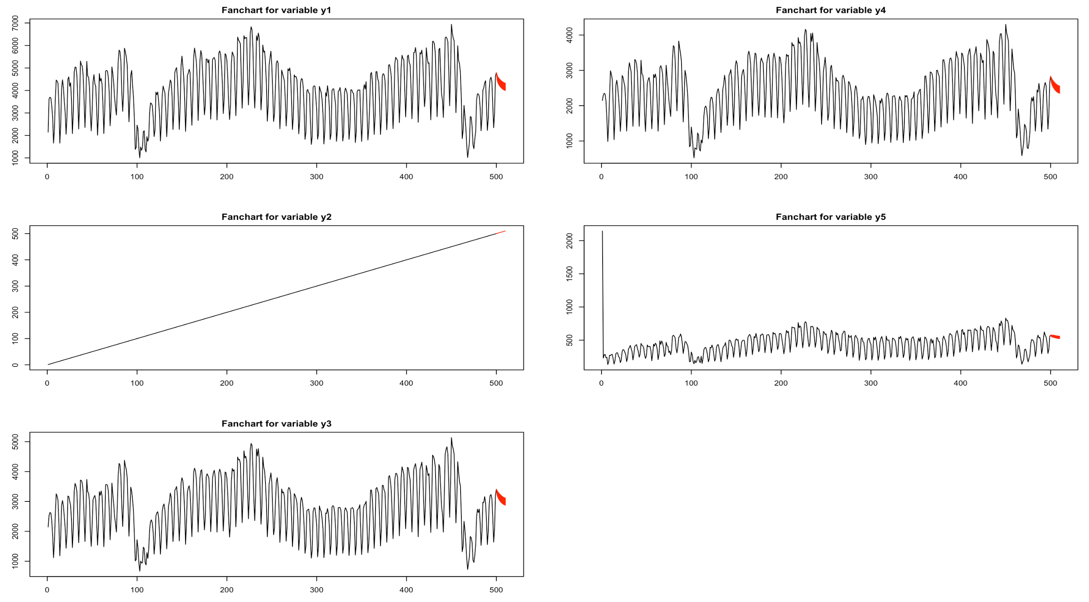
Model 5 – VAR
Page.Loads
First.Time.Visits
Page Loads (Response variable)
First Time Visits
Day
Returning.Visits
Day
Returning Visits
Unique.Visits
Unique.Visits
Notes:
Although seemingly a bad model, there is an interesting finding with this fanchart. We see that Page.Loads, Day, Unique Visits, and First.Time.Visits provide more information predicting Returning.Visits judging by the small confidence interval. VAR model would have worked better if we were to predict Returning.Visits.

Slide 22
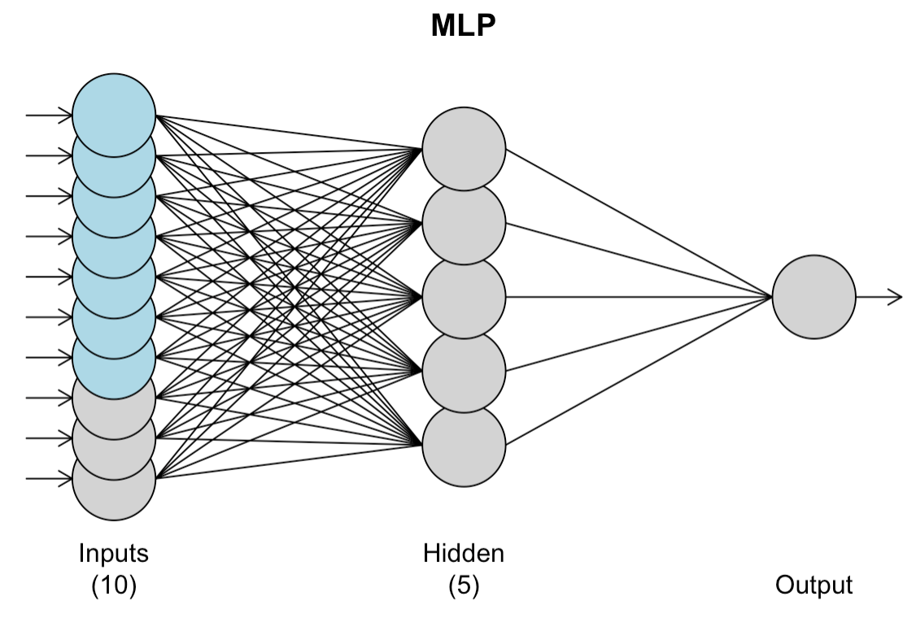
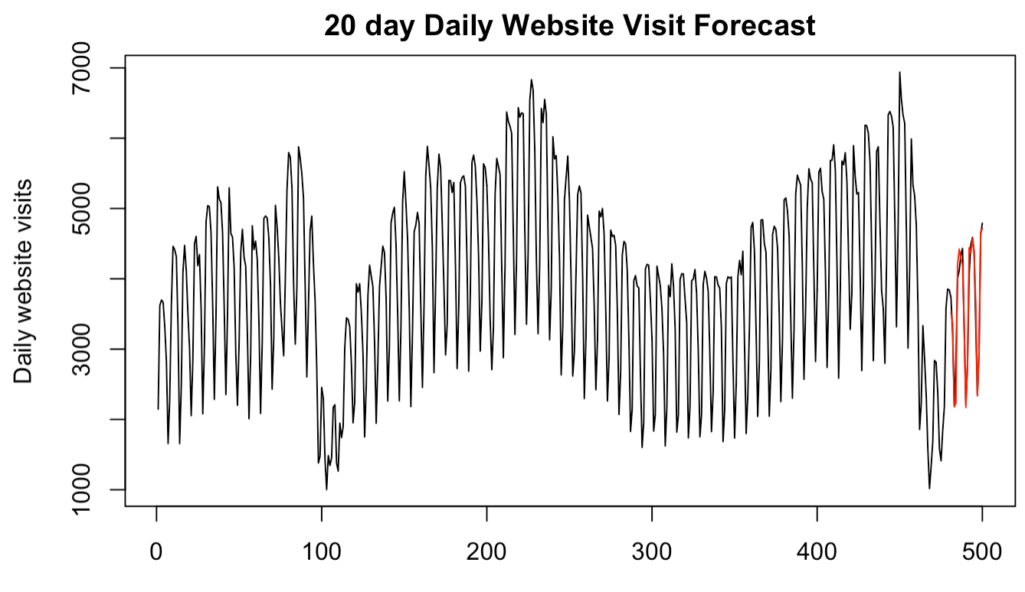
Model 6 – Neural network with known variables
Validating the model with last 20 days
ASE = 44181.51
Notes:
Next I tried a neural network with known variables. and this picture is multilayer perceptron. It has 10 inputs of various lags, 5 hidden nodes and 1 output, which is the forecast. The forecasts were pretty spot on with a low ASE.

Slide 23
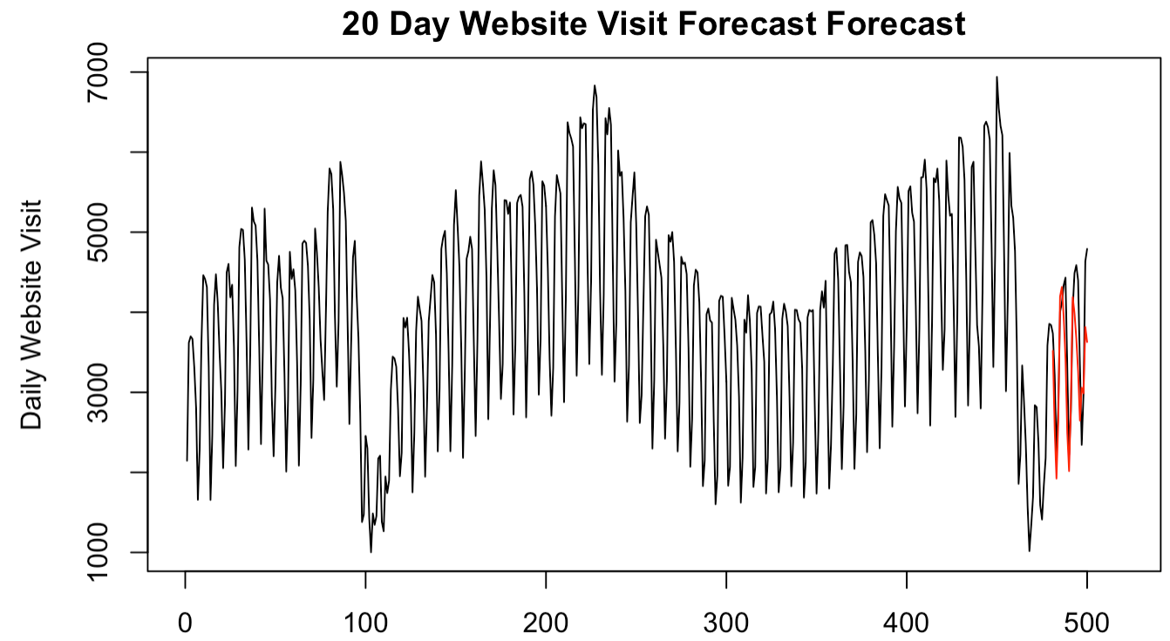
Model 7 – Neural network with forecast variables
Validating the model with last 20 days
ASE = 399740.1
Notes:
This time, the model was created using the forecasted variables. As a result, the forecasts were much less accurate as expected

Slide 24
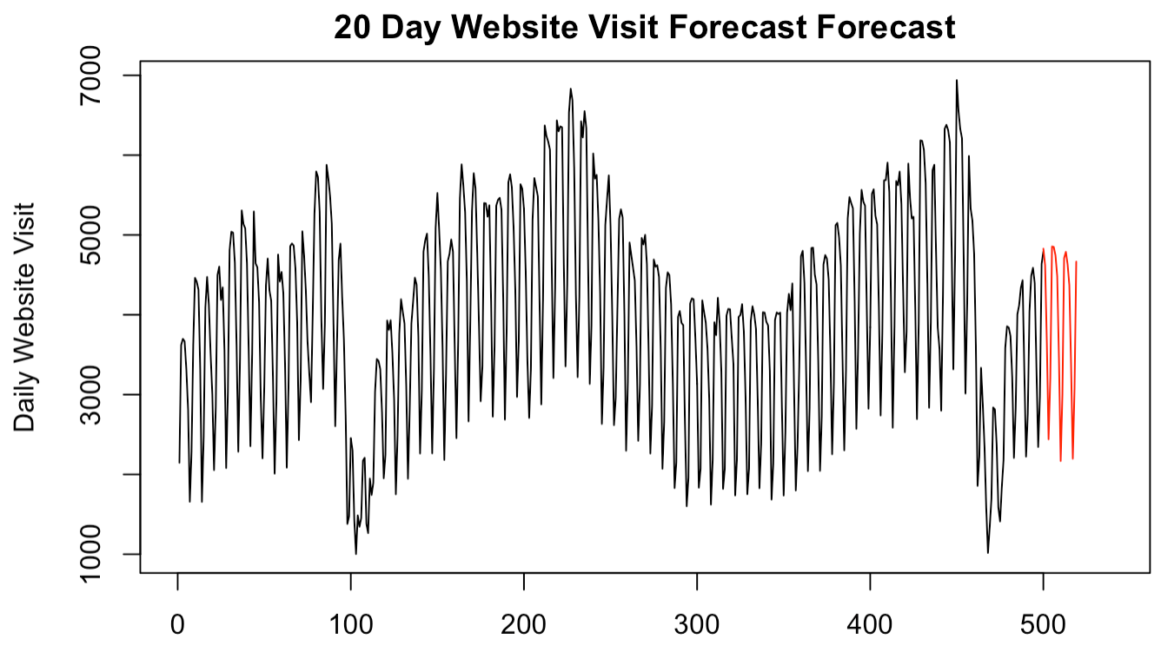
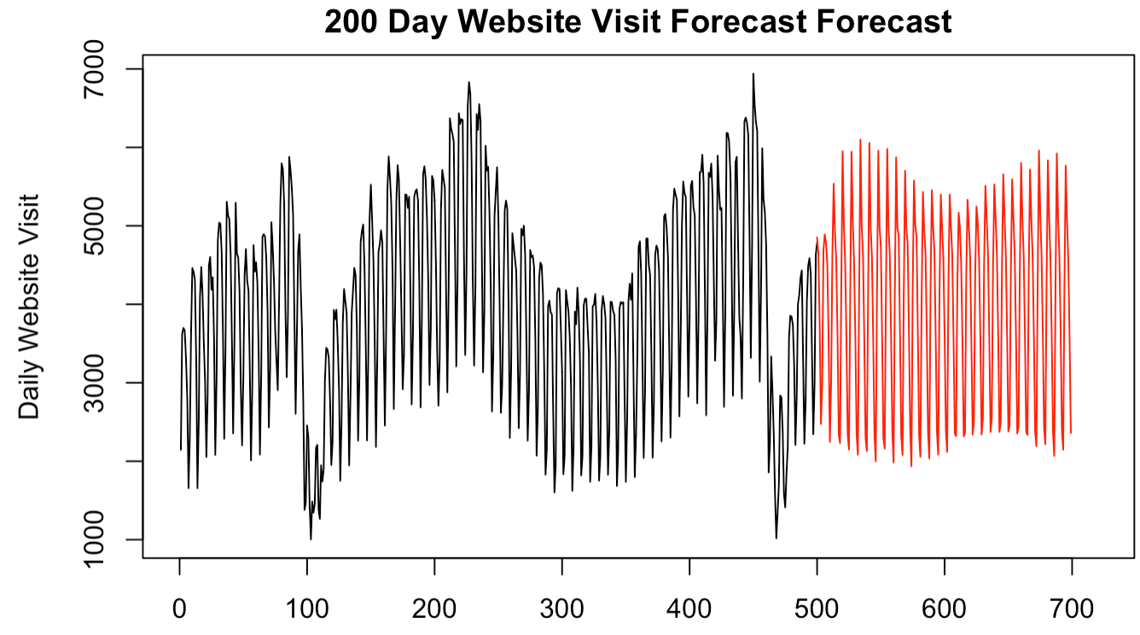
Model 7 – Neural network with forecast variables
Short term prediction – 20 days ahead
Long term prediction – 200 days ahead
Notes:
Here we see that neural network was able to capture not only the seasonality but the overall trend as well.

Slide 25
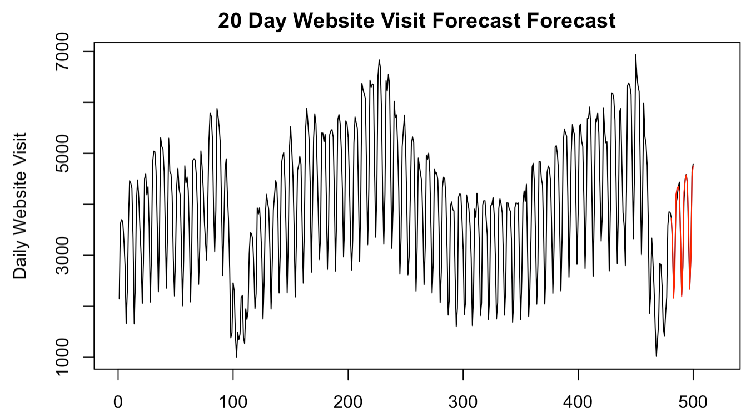
Model 8 – Ensemble (MLR + NN with known variables)
Validating the model with last 20 days
ASE = 16384.07
Notes:
Here, an ensemble model was created with the average of the best two models: Multiple linear regression and neural network model. It performed fairly well as expected with ASE of 16000

Slide 26
Conclusion
ASE for last 20 days prediction
Model | ASE
ARMA(5,2) | 444329
ARIMA(3,1,1) with s=7 | 646923
ARIMA(3,0,2) with s=7 | 934133
Multilinear Regression (MLR) – BEST model | 10403
Vector Autoregressive (VAR) | 1105381
Neural Network with Known variables | 44181
Neural Network with Forecasted variables | 399740
Ensemble (MLR + Neural network with Known variables) | 16384
Long term prediction
Short term prediction
Notes:
Lastly, all the models are compared against each other. The model with the best ASE over the last 20 days was Multiple linear regression with ASE of only 10,000. However it is important to note that it was based on the true values of the regressors.
For that reason, Multiple linear regression model will be limited to short term prediction.

Slide 27
Conclusion
Long-term forecast - Neural Network with forecasted regressors
Notes:
For long term forecast, I would choose ARIMA(3,0,1) with a seasonality of 7 as it fairly stays within the reasonable range of a typical internet traffic and most importantly, does not have to take so much of uncertainties around the forecasted variables like multivariate models, not to mention it is unrealistic to have the true future values of regressors.
For further research, I wish to incorporate more explanatory variables such as website maintenance schedule, school events or conference that can possibly boost website traffic periodically. These extra variables can certainly contribute to more powerful models.

Slide 28
End
Notes:
That concludes my presentation, thank you for watching.

Slide 29
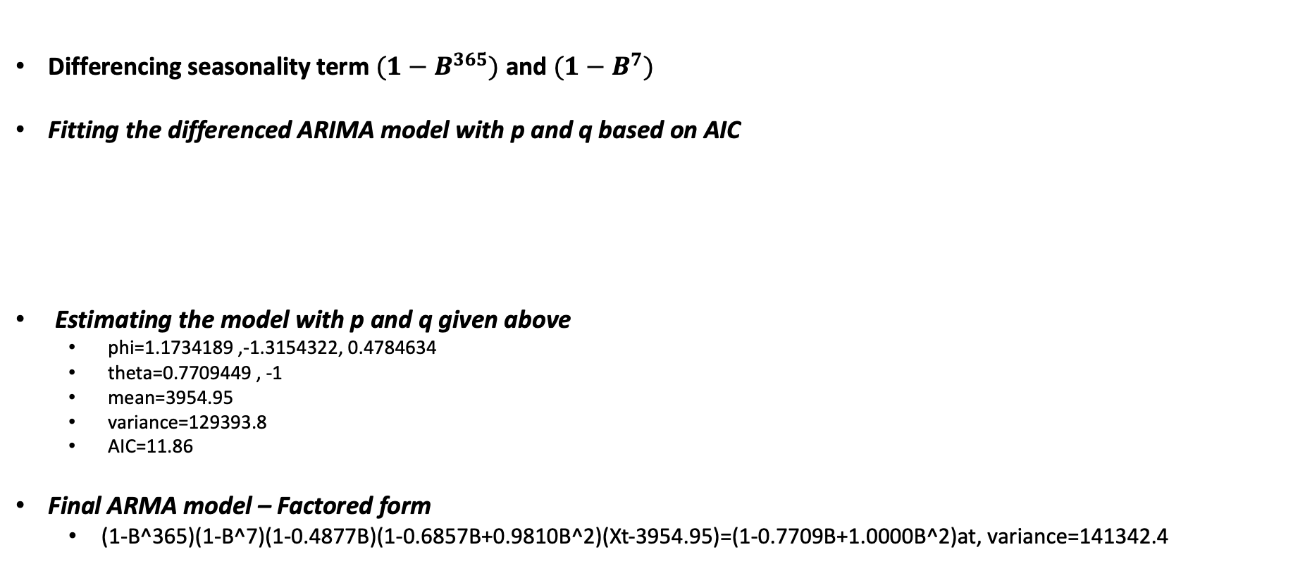
Model 3 – ARIMA(3,0,2) with s=365 and 7, no unit root term
Differencing seasonality term $({1−B}^{365})$ and $({1−B}^{7})$
Fitting the differenced ARIMA model with p and q based on AIC
Estimating the model with p and q given above
phi=1.1734189 ,-1.3154322, 0.4784634
theta=0.7709449 , -1
mean=3954.95
variance=129393.8
AIC=11.86
Final ARMA model – Factored form
(1-B^365)(1-B^7)(1-0.4877B)(1-0.6857B+0.9810B^2)(Xt-3954.95)=(1-0.7709B+1.0000B^2)at, variance=141342.4
Notes:
Here in this new model, Instead of taking out the unit room term, I differenced the period of 365, which is pretty close to the unit term and wanted to see how it changes the forecasting.

Slide 30
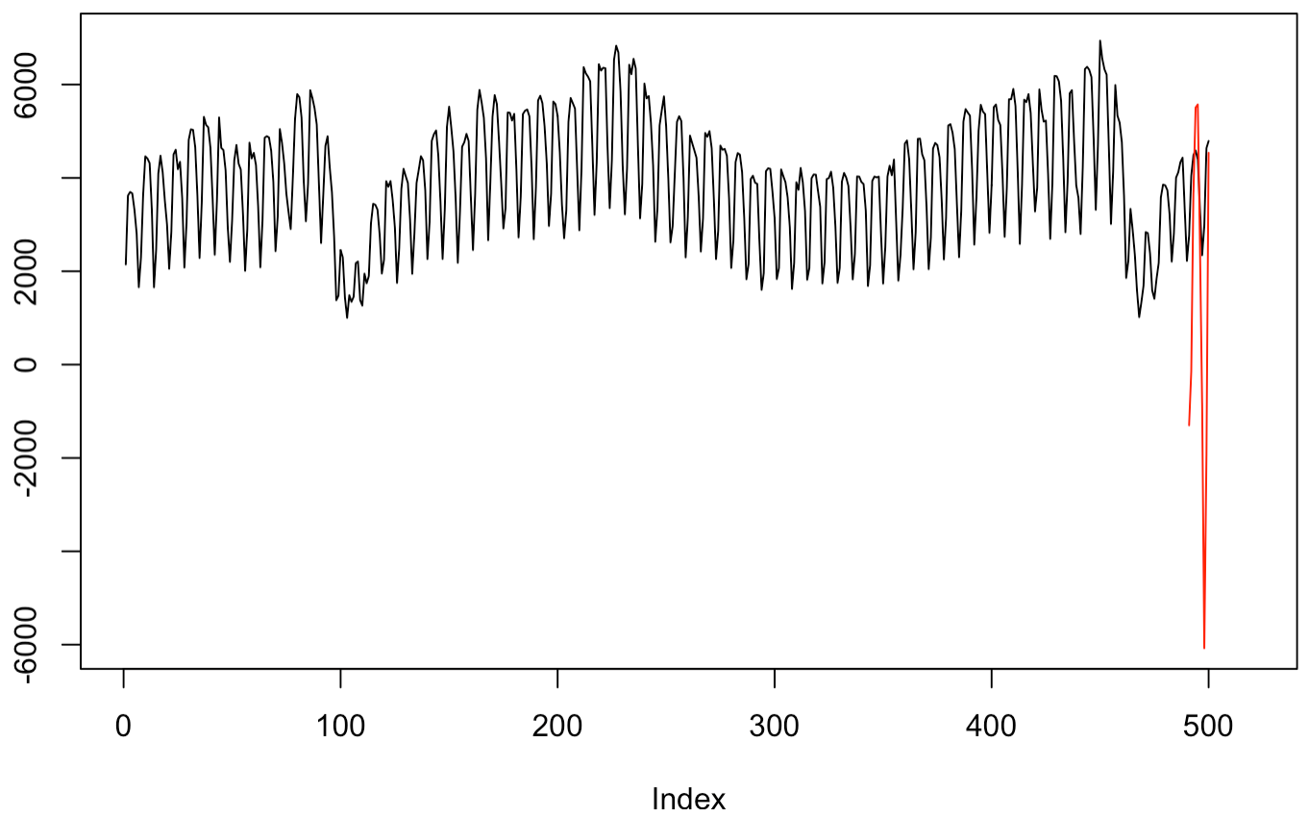
Model 3 – ARIMA(3,0,2)
Validating the model with last 20 data points
ASE = 17315942
Notes:
The forecasts bounced up and down and showed a great volatility even though it centered around the mean.

Slide 31
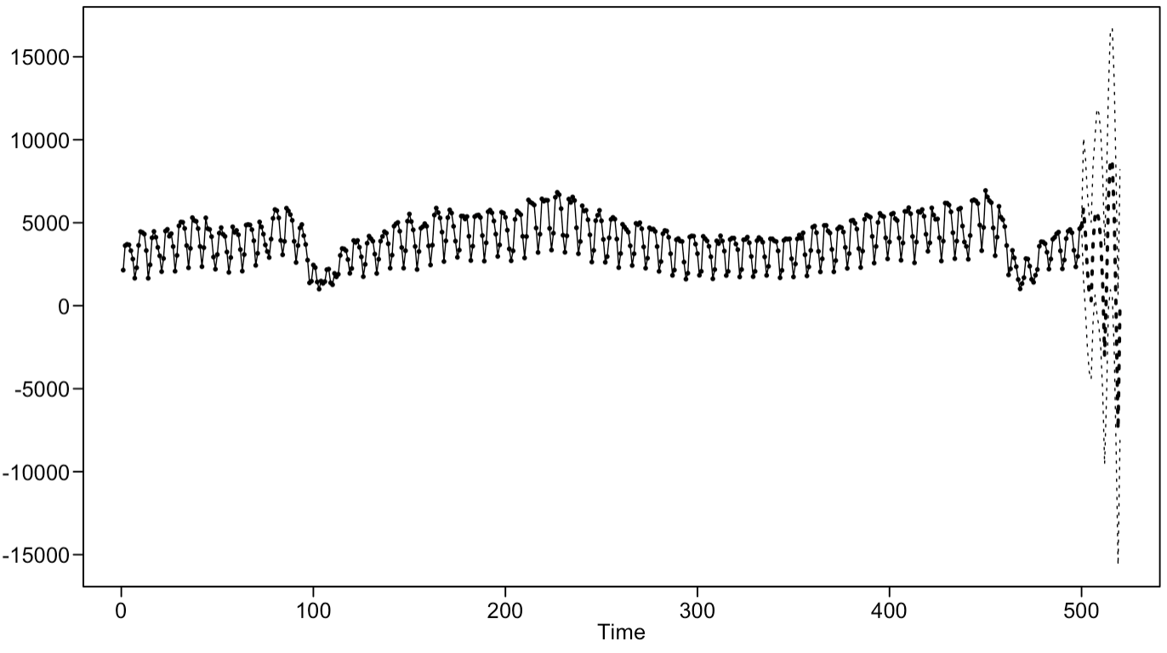
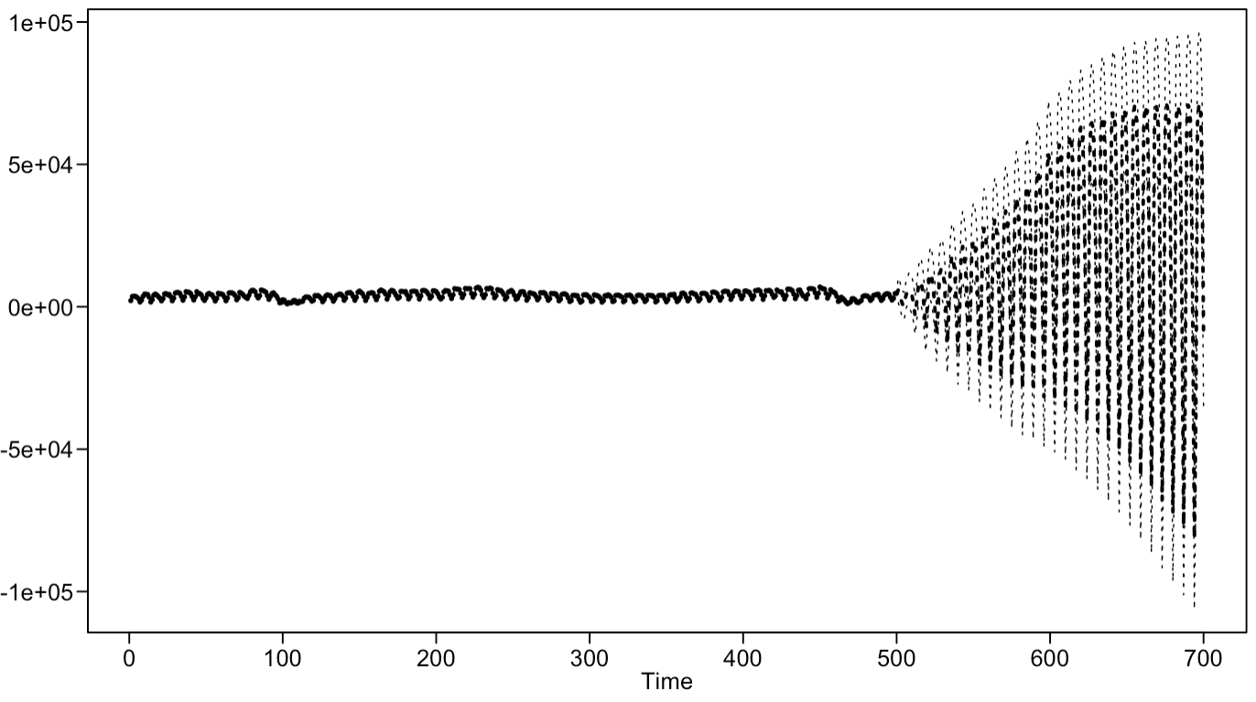
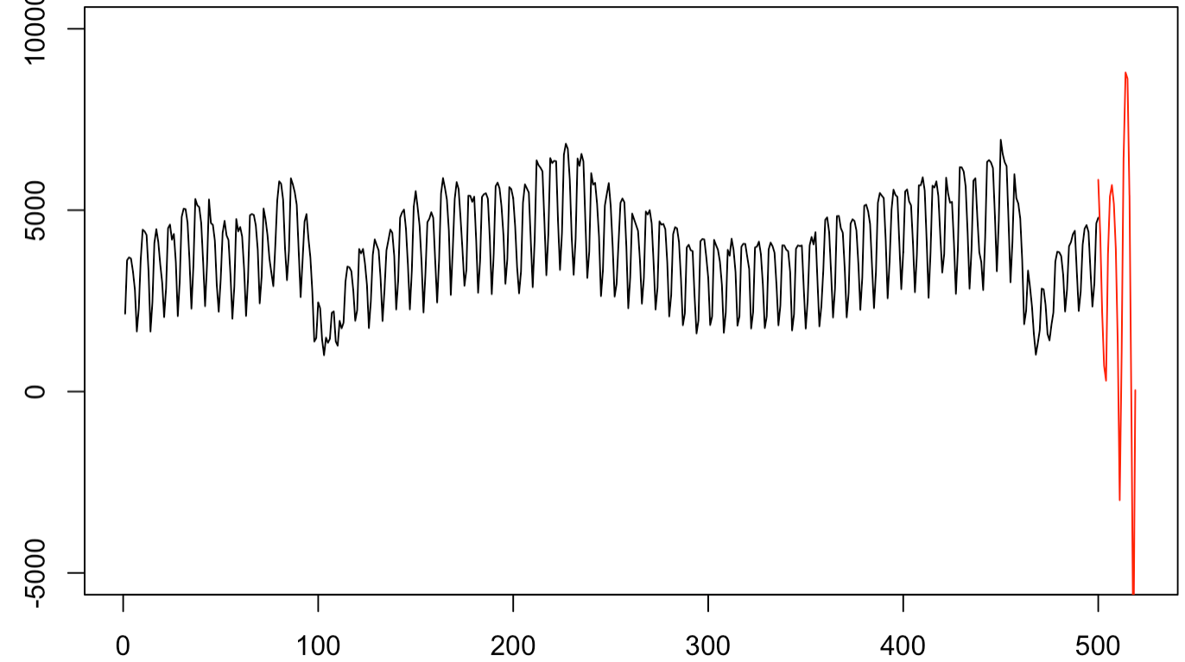
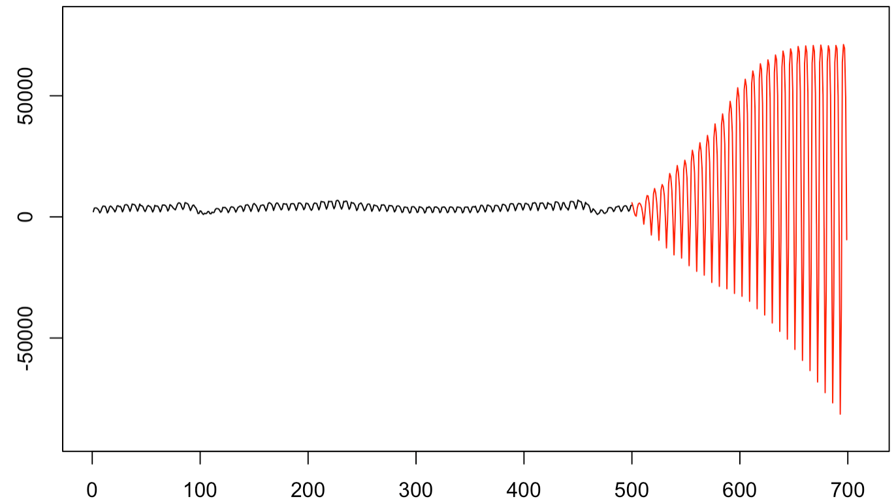
Model 3 – ARIMA(3,0,2)
Short term prediction – 20 days ahead
Long term prediction – 200 days ahead
Notes:
For this model, the forecasts and prediction limits grow sideways as the time goes. The longer the forecasting is, the worse the model performs.

